Slide 1
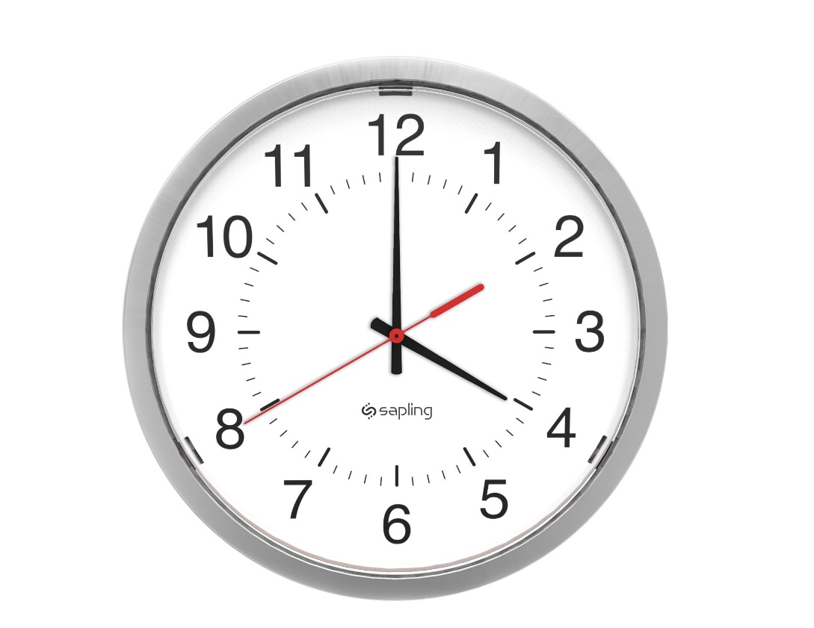
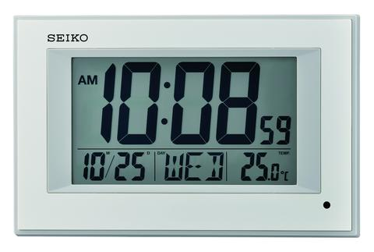
Analog V/s Digital

Slide 2
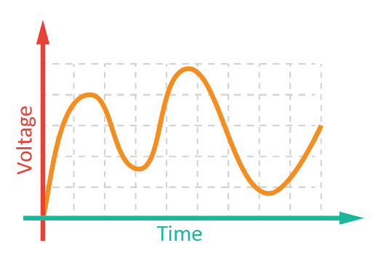
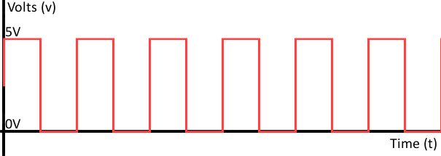
Analog V/s Digital Graphs

Slide 3
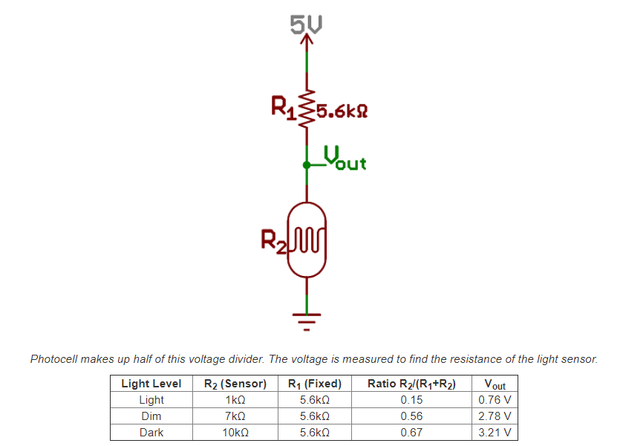
Analog Circuit: Photocell Voltage Divider

Slide 4
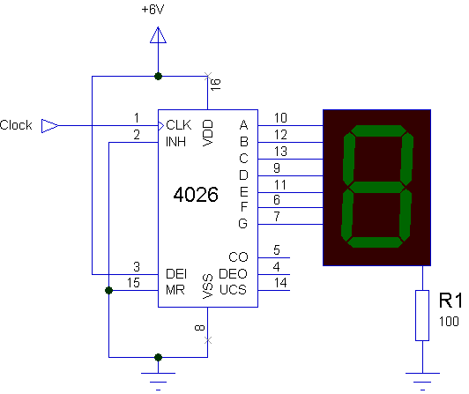
Digital Circuit: Seven Segment Counter

Slide 5
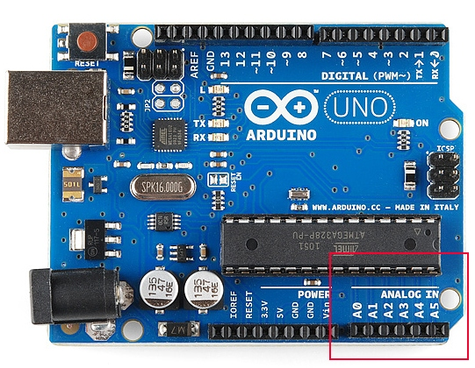
ADC – Analog to digital Convertion
What is the ADC?
An Analog to Digital Converter (ADC) is a very useful feature that converts an analog voltage on a pin to a digital number.
The ADC on the Arduino is a 10-bit ADC meaning it has the ability to detect 1,024 (2¹⁰) discrete analog levels. Some microcontrollers have 8-bit ADCs (2⁸ = 256 discrete levels) and some have 16-bit ADCs (2¹⁶ = 65,536 discrete levels).

Slide 6
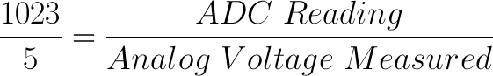
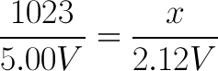
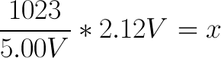
ADC value to Voltage
The ADC reports a ratiometric value. This means that the ADC assumes 5V is 1023 and anything less than 5V will be a ratio between 5V and 1023.
Analog to digital conversions are dependant on the system voltage. Arduino use the 10-bit ADC on a 5V system, If your system is 3.3V, you simply change 5V out with 3.3V in the equation.
If the analog voltage is 2.12V what will the ADC value?

Slide 7
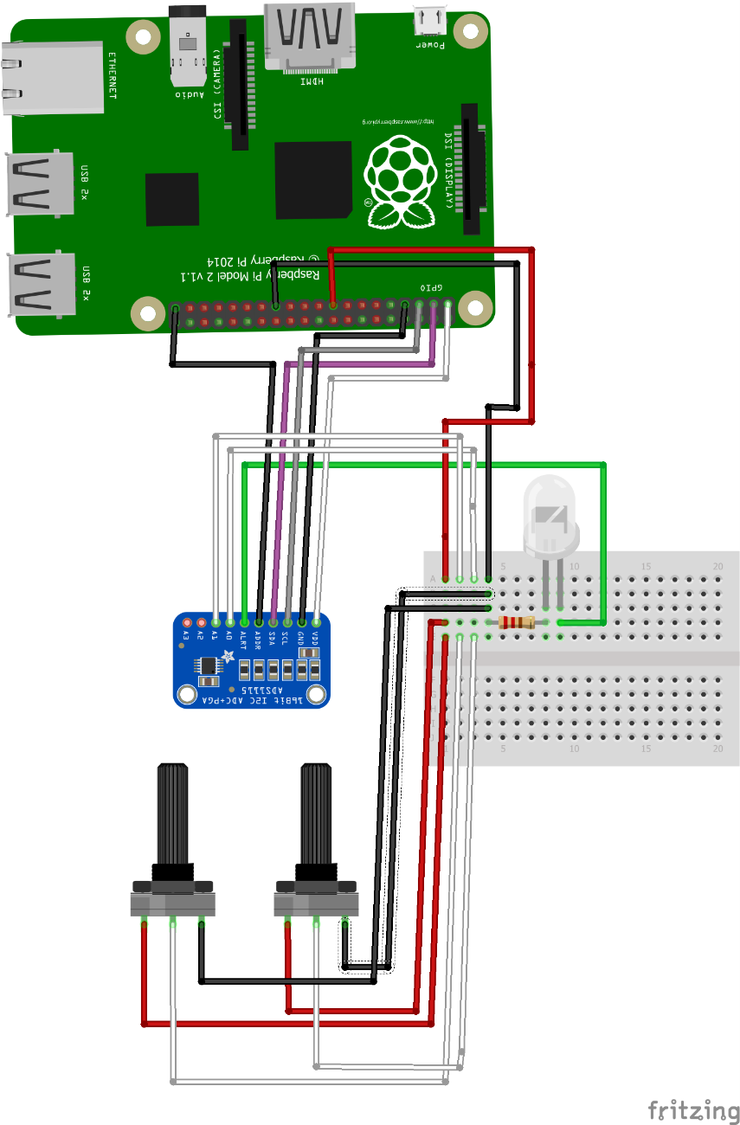
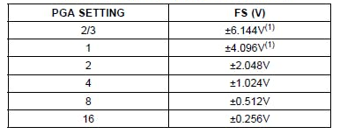
ADS115 – ADC interfacing with Raspberry pi
ADS115
The ADS1115 is great analog to digital converters that are easy to use with the Raspberry Pi using its I2C communication bus. The ADS1115 is a higher precision 16-bit ADC with 4 channels and have a programmable gain from 2/3x to 16x so you can amplify small signals and read them with higher precision.

Slide 8
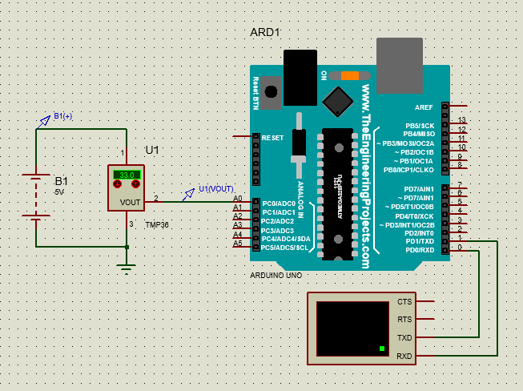
Interfacing TMP36 with Arduino Uno
TMP36
Voltage Input: 2.7 V to 5.5 VDC
10 mV/°C scale factor
±2°C accuracy over temperature
±0.5°C linearity
Operating Range: −40°C to +125°C
The analog voltage reading will range from about 0V (ground) to about 1.75V. We had used 5v to power the sensor, and connecting the sensor directly into an Analog pin, We can use these formulas to turn the 10-bit analog reading into a temperature:
Voltage at pin A0 in milliVolts = (reading from ADC) * (5000/1024) This formula converts the number 0-1023 from the ADC into 0-5000mV (= 5V)
Then, to convert millivolts into temperature, use this formula:
Centigrade temperature = [(analog voltage in mV) - 500] / 10

Slide 9
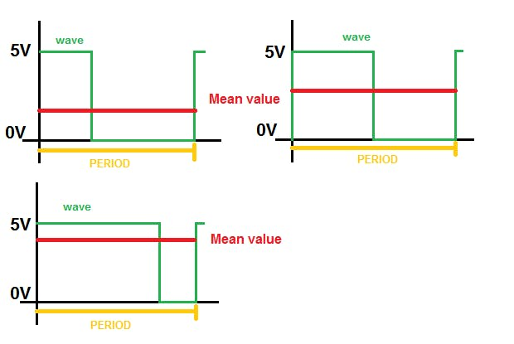
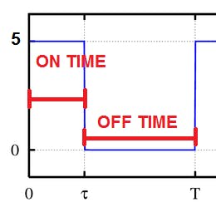
DAC –Digital to Analog & PWM
A DAC is a circuit that allows you to translate numeric values into analog signals.
PWM & Duty Cycle
The duty-cycle is the ratio of the ON time and the total period of the wave. The ON time is the amount of time in which the wave stays at 5V and the total period is the sum of the time while it stays at 5V and 0V time.
When you use the AnalogWrite function you set the output duty cycle that may vary between 0% and 100% and you choose these values with the second parameter you pass to the function ( 0÷255).
DC = ON TIME/(OFF TIME + ON TIME)
Mean Value and Duty Cycle
The mean value of a wave is the average of the voltage provided from the output over a period time of the wave.
The square waveform with amplitude 0V-5V has a mean value that is equal to the max amplitude (5V) multiplied for the duty-cycle. This means that you can change the mean value of the PWM output by using the (AnalogWrite(pin,127)) .
You will have 2.5v Average value if you set it 50%.

Slide 10
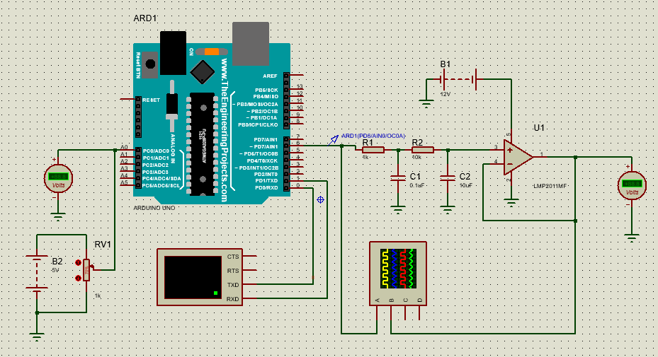
PWM Output & Low Pass Filters

Slide 11
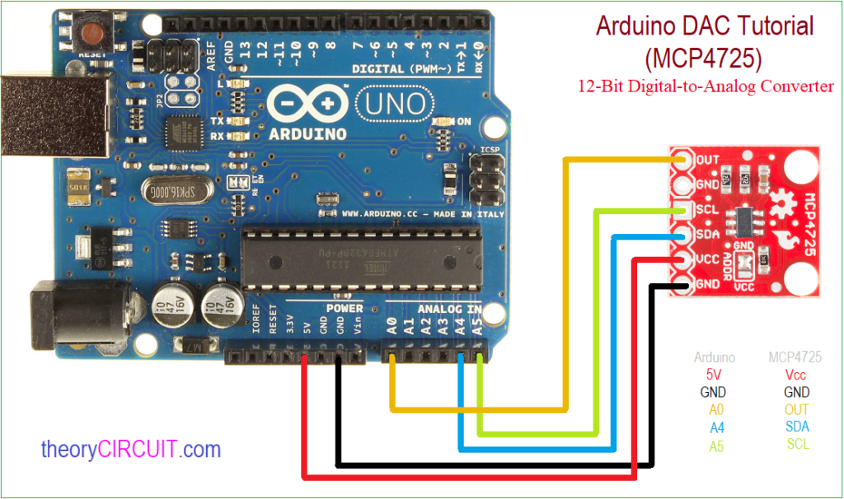
Interfacing DAC with Arduino Uno
MCP4725
This IC provides 12 bit resolution and on board Board Non-Volatile Memory (EEPROM). It can be addressed by external A0 address pin, and operates in Normal or Power-Down Mode. It takes wide range of input supply voltage as 2.7V to 5.5V from single supply source. This IC provides eight address through I2C and have Extended Temperature Range: -40°C to +125°C.
Applications
Sensor Calibration
PC Peripherals
Data Acquisition Systems
Low Power Portable Instrumentation

Slide 12
Types of Communications
1
SPI – Serial Peripheral Interface
2
I2c – Inter Integrated Circuit
3
UART & USART – Universal Synchronous Asynchronous Receiver Transmitter

Slide 13
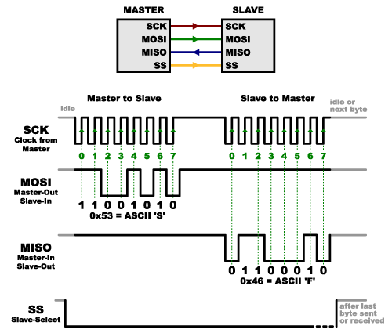
SPI – Serial Peripheral Interface
Serial Peripheral Interface (SPI) is an interface bus commonly used to send data between microcontrollers and small peripherals such as shift registers, sensors, and SD cards. It uses separate clock and data lines, along with a select line to choose the device you wish to talk to.
In SPI, only one side generates the clock signal (usually called CLK or SCK for Serial ClocK). The side that generates the clock is called the “master”, and the other side is called the “slave”. There is always only one master (which is almost always your microcontroller), but there can be multiple slaves (more on this in a bit).
When data is sent from the master to a slave, it’s sent on a data line called MOSI, for “Master Out / Slave In”. If the slave needs to send a response back to the master, the master will continue to generate a prearranged number of clock cycles, and the slave will put the data onto a third data line called MISO, for “Master In / Slave Out”.
SPI is “full duplex”

Slide 14
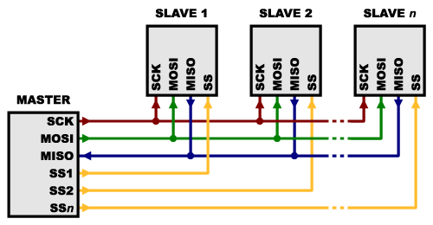
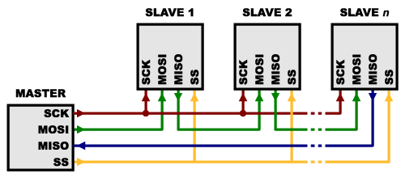
SPI – Multiple Slaves
There are two ways of connecting multiple slaves to an SPI bus:
Each slave will need a separate SS line. To talk to a particular slave, you’ll make that slave’s SS line low and keep the rest of them high.
Daisy-chained together, with the MISO (output) of one going to the MOSI (input) of the next. In this case, a single SS line goes to all the slaves. Once all the data is sent, the SS line is raised, which causes all the chips to be activated simultaneously. This is often used for daisy-chained shift registers and addressable Led Drivers.

Slide 15
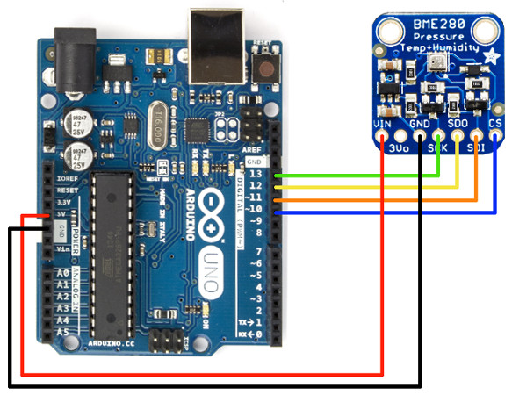
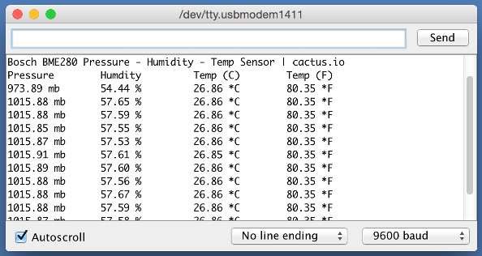
SPI- Interfacing BME280 Sensor
BME280
The BME280 from Bosch Sensortec is a integrated environmental sensor designed for the mobile market. It a low power consumption design that combines high linearity and high accuracy sensors for pressure, humidity and temperature.

Slide 16
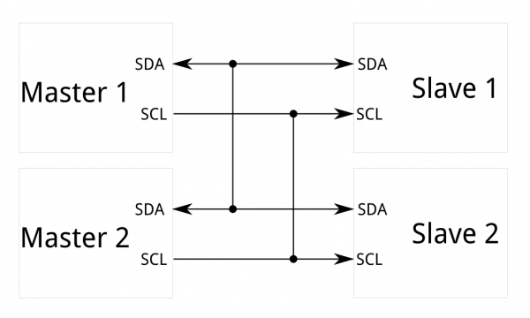
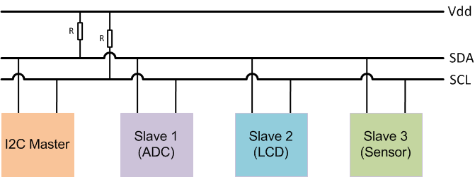
I2c – Inter-integrated Circuit
The Inter-integrated Circuit (I²C) Protocol is a protocol intended to allow multiple “slave” digital integrated circuits (“chips”) to communicate with one or more “master” chips. Like the Serial Peripheral Interface (SPI), it is only intended for short distance communications within a single device. Like Asynchronous Serial Interfaces (such as RS-232 or UARTs), it only requires two signal wires to exchange information.
I²C requires a mere two wires, like asynchronous serial, but those two wires can support up to 1008 slave devices. Also, unlike SPI, I²C can support a multi-master system, allowing more than one master to communicate with all devices on the bus.
Data rates fall between asynchronous serial and SPI; most I²C devices can communicate at 100kHz or 400kHz.

Slide 17
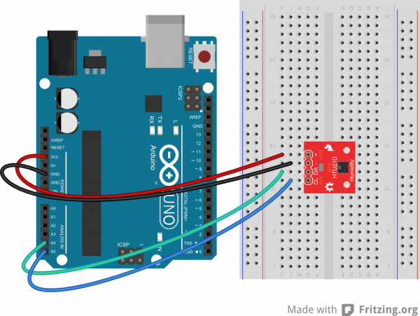
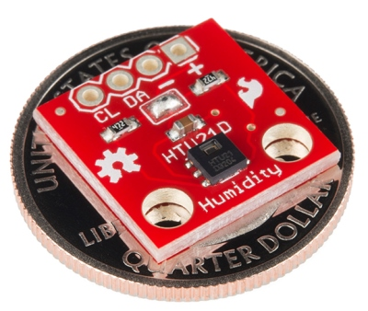
I2C- Interfacing HTU21D Sensor
HTU21D
The HTU21D is a low-cost, easy to use, highly accurate, digital humidity sensor. All you need is two lines for I²C communication and you’ll have relative humidity readings such as “45.2%” or “23.1%” and very accurate temperature readings as a bonus!.

Slide 18
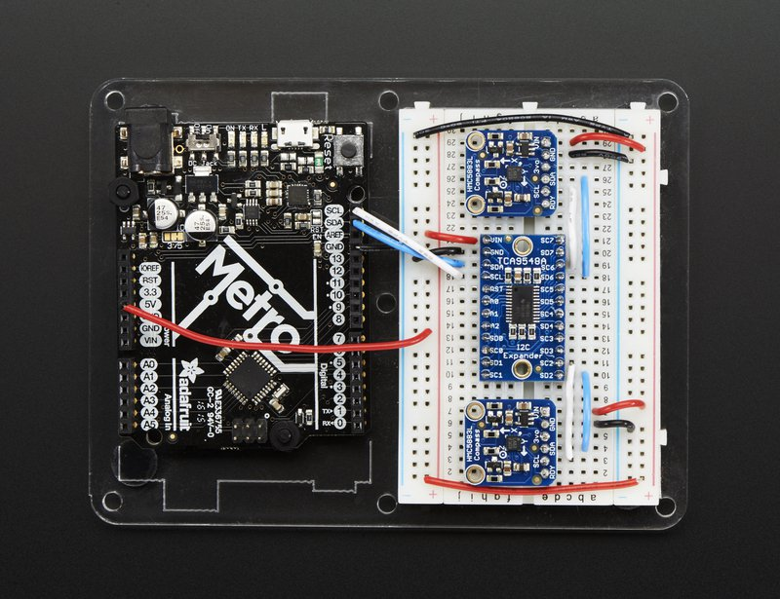
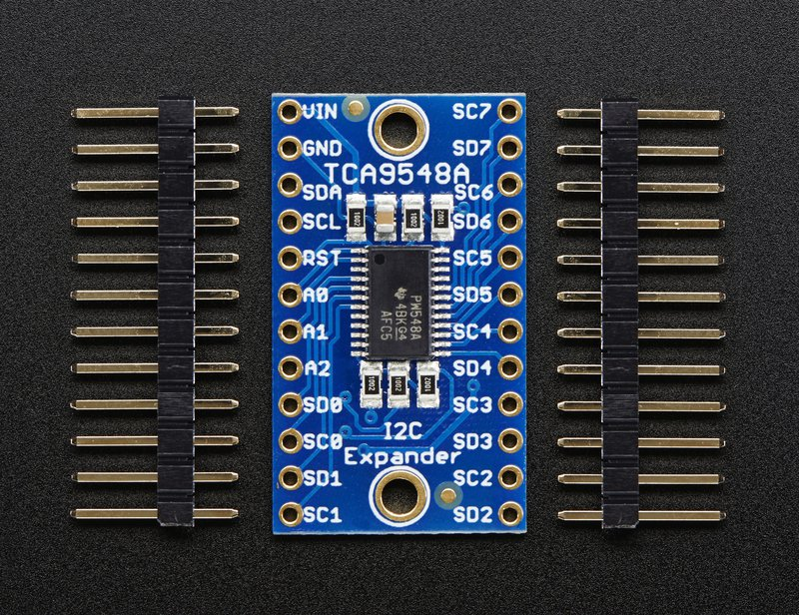
I2C- TCA9548A 1 to 8 I2C Multiplexer
TCA9548A

Slide 19
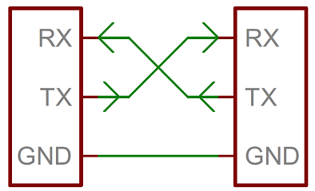
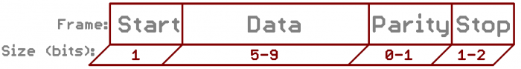
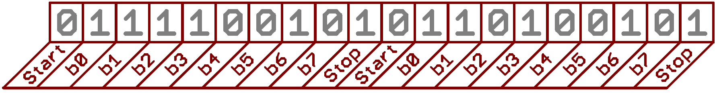
Serial Communication UART
Baud Rate
The baud rate specifies how fast data is sent over a serial line. It’s usually expressed in units of bits-per-second (bps). One of the more common baud rates, especially for simple stuff where speed isn’t critical, is 9600 bps. Other “standard” baud are 1200, 2400, 4800, 19200, 38400, 57600, and 115200.
Framing the data
Each block (usually a byte) of data transmitted is actually sent in a packet or frame of bits. Frames are created by appending synchronization and parity bits to our data.
A serial bus consists of just two wires - one for sending data and another for receiving. As such, serial devices should have two serial pins: the receiver, RX, and the transmitter, TX.

Slide 20
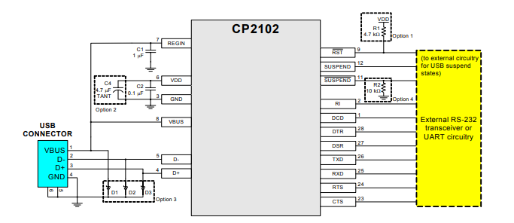
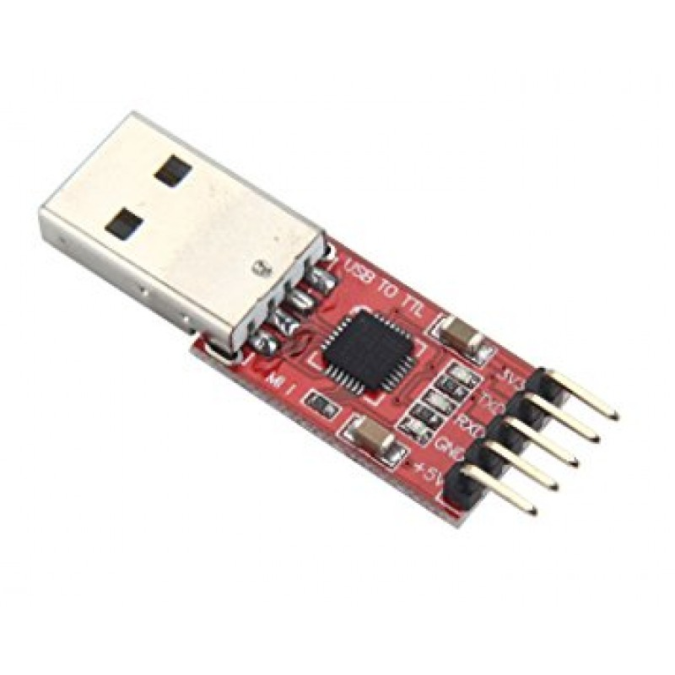
CP2102- Single Chip USB to UART Bridge
CP2102
The CP2102 is a highly-integrated USB-to-UART Bridge Controller providing a simple solution for updating RS-232 designs to USB using a minimum of components and PCB space. The CP2102 includes a USB 2.0 full-speed function controller, USB transceiver, oscillator, EEPROM, and asynchronous serial data bus (UART) with full modem control signals in a compact 5 x 5 mm MLP-28 package. No other external USB components are required.

Slide 21
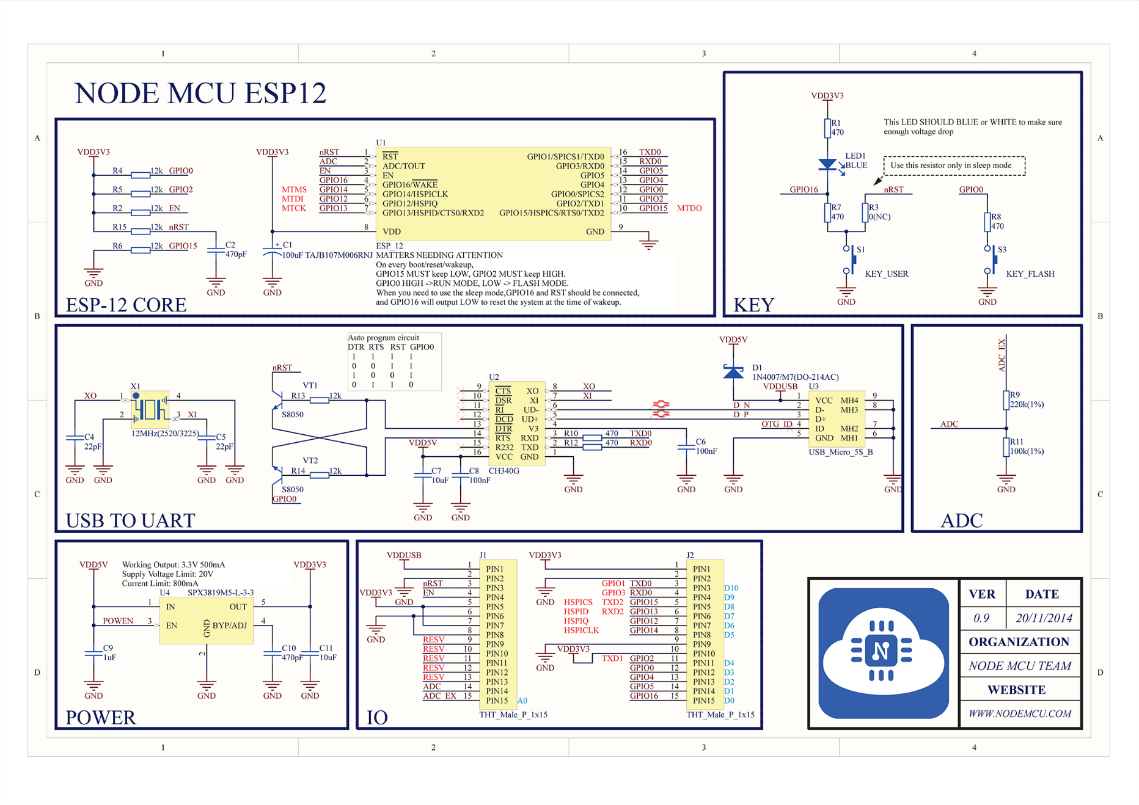
Node MCU ESP 12

Slide 22
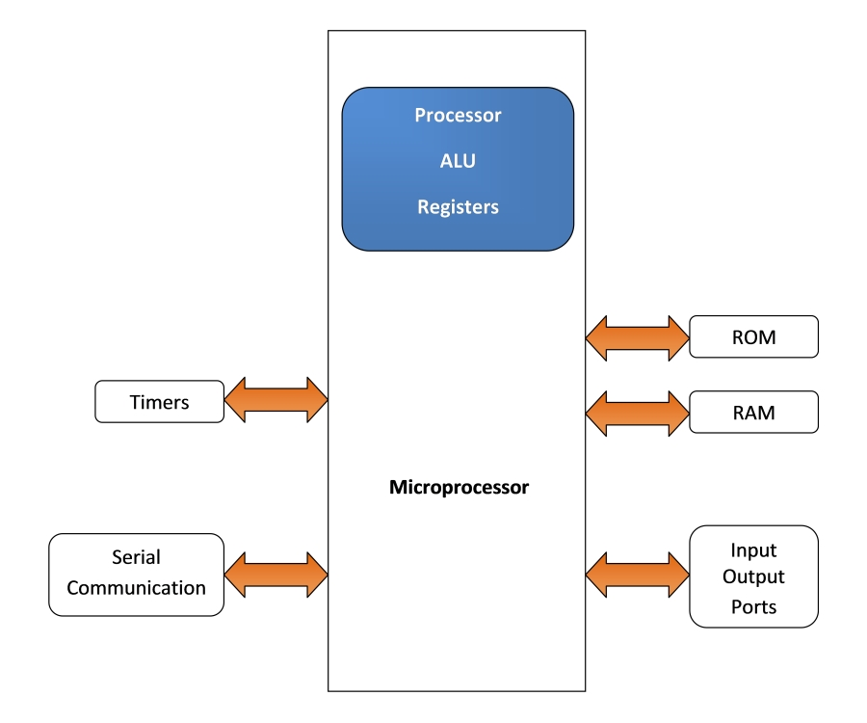
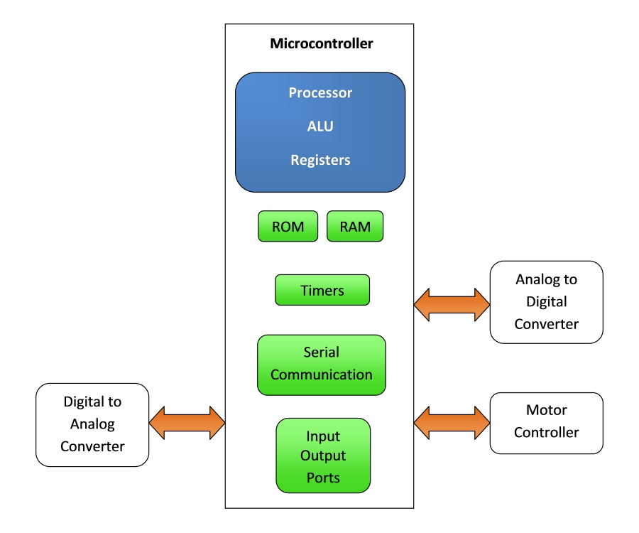
Microprocessors Vs Microcontrollers

Slide 23
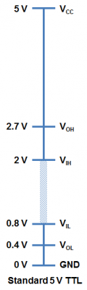
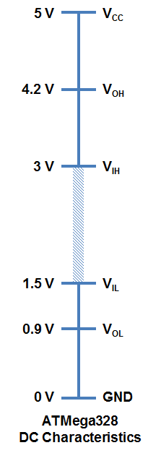
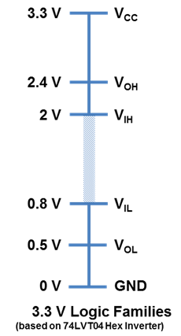
Logic Level
TTL Logic Levels
The A majority of systems we use rely on 5 V TTL Logic Levels. TTL is an acronym for Transistor-Transistor Logic. It relies on circuits built from bipolar transistors to achieve switching and maintain logic states.
V_{OH} – Minimum OUTPUT Voltage level a TTL device will provide for a HIGH signal.
V_{IH} – Minimum INPUT Voltage level to be considered a HIGH.
V_{OL} – Maximum OUTPUT Voltage level a device will provide for a LOW signal.
V_{IL} – Maximum INPUT Voltage level to still be considered a LOW.

Slide 24
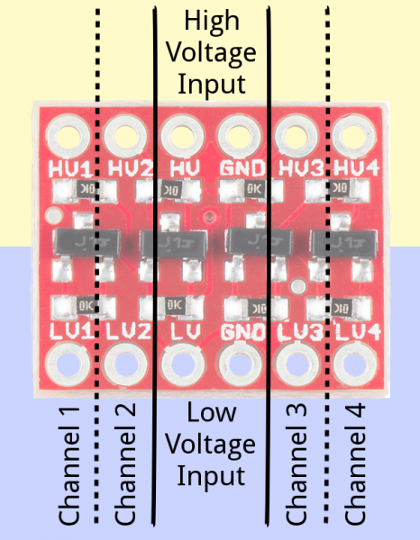
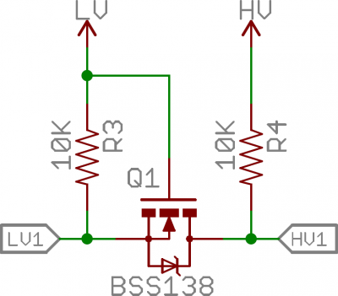
Bi-Directional Logic Level Converter
TTL Logic Levels
Do you have a 3.3V I²C or SPI sensor that might go up in smoke if connected to a 5V Arduino? Or a 5V device that needs a workaround to be compatible with your 3.3V Raspberry pi, Arduino Due.
The circuit uses a single N-channel MOSFET and a couple pull-up resistors to realize bi-directional level shifting.

Slide 25
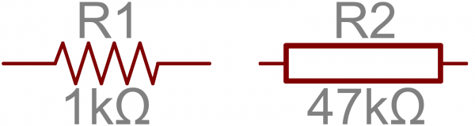
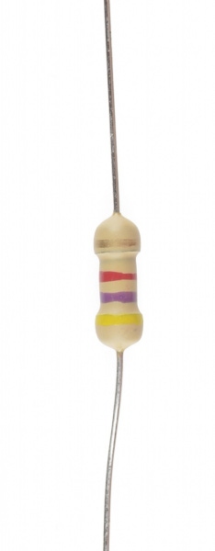
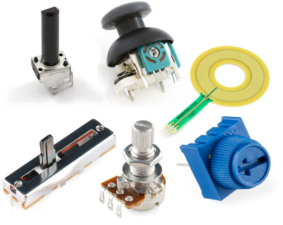
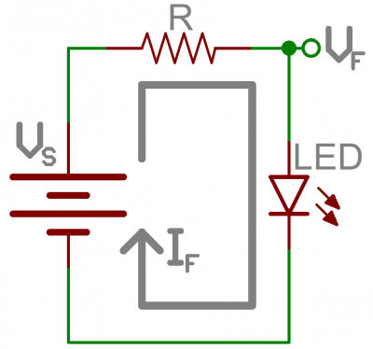
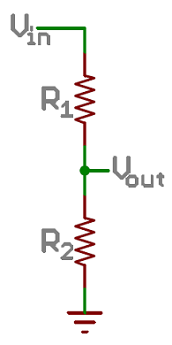
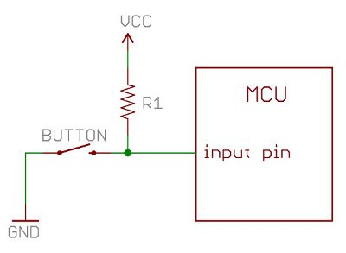
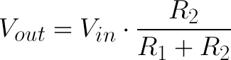
Resistors
What is a Resistor?
Resistors are electronic components which have a specific, never-changing electrical resistance. The resistor’s resistance limits the flow of electrons through a circuit.
They are passive components, meaning they only consume power (and can’t generate it). Resistors are usually added to circuits where they complement active components like op-amps, microcontrollers, and other integrated circuits.. Commonly resistors are used to limit current, divide voltages, and pull-up I/O lines. The electrical resistance of a resistor is measured in ohms
Applications
LED Current Limiting
Voltage Divider
Pull Up And Pull Down resistors

Slide 26
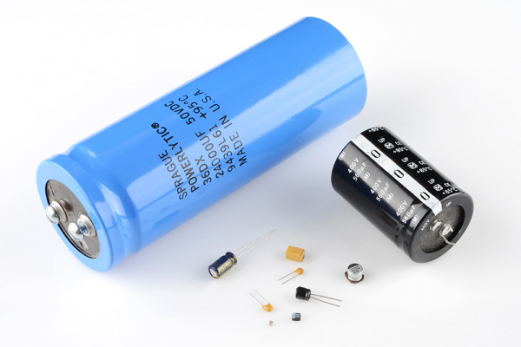
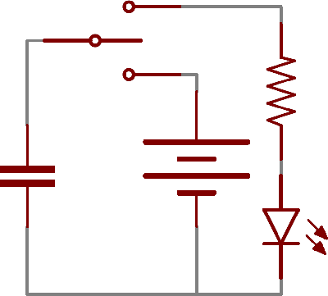


Capacitors
What is capacitors?
A capacitor is a two-terminal, electrical component. Along with resistors and inductors, they are one of the most fundamental passive components we use.
Application
Decoupling (Bypass) Capacitors
Power Supply Filtering
Signal Filtering

Slide 27





Diodes
What Is a Diode?
The key function of an ideal diode is to control the direction of current-flow. Current passing through a diode can only go in one direction, called the forward direction.
Applications
Half wave and Full wave rectifiers.
Reverse Current Protections
Flyback Diodes and Voltage Spike Suppression
Logic Gates

Slide 28





Transistors
Transistors
In small, discrete quantities, transistors can be used to create simple electronic switches, digital logic, and signal amplifying circuits. In quantities of thousands, millions, and even billions, transistors are interconnected and embedded into tiny chips to create computer memories, microprocessors, and other complex ICs.
Application
Transistors Switch
Digital Logics
H Bridge
Oscillator
Amplifiers

Slide 29


Relays
What is a Relay?
A relay is an electrically operated or electromechanical switch composed of an electromagnet, an armature, a spring and a set of electrical contacts.

Slide 30

Temperature Based Relay switch

